Slide 1
Histogram Processing

Slide 2
1. Basics

Slide 3
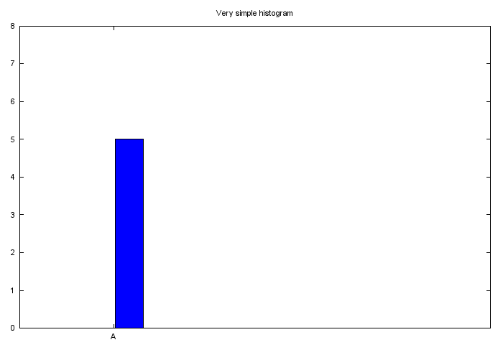
What is a Histogram ?
A histogram is a graph. Usually histogram have bars that represent frequency of occurring of data in the whole data set.
Not exactly a bar chart though!

Slide 4
Image Histogram
An image histogram is a type of histogram that acts as a graphical representation of the tonal distribution in a digital image.
Horizontal axis - tonal variations , vertical axis - the number of pixels in that particular tone.
The left side of the x axis represents the black and dark areas, the middle represents medium grey and the right side represents light and pure white areas.
The y axis represents the size of the area that is captured in each one of these zones.

Slide 5
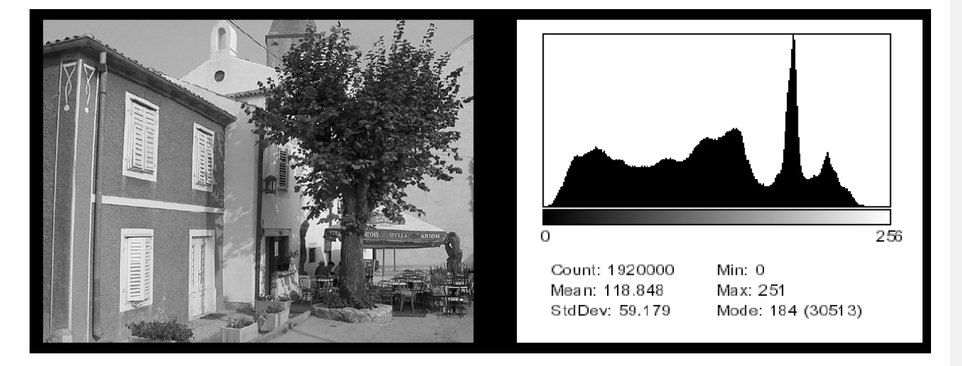
Image (left) has 256 distinct gray levels (8 bits)
Histogram shows frequency (x times) each gray level (intensity values) occurs.

Slide 6
Image with gray levels[0 to L-1] is a discrete function :
h(r_{k} ) = n_{k}
Where r_{k} is the kth gray level and
n_{k} is the number of pixels having gray level r_{k.}
Normalized Histogram is given by :
p(r_{k}) = n_{k}/n
where k =0, 1, ….., L-1.

Slide 7
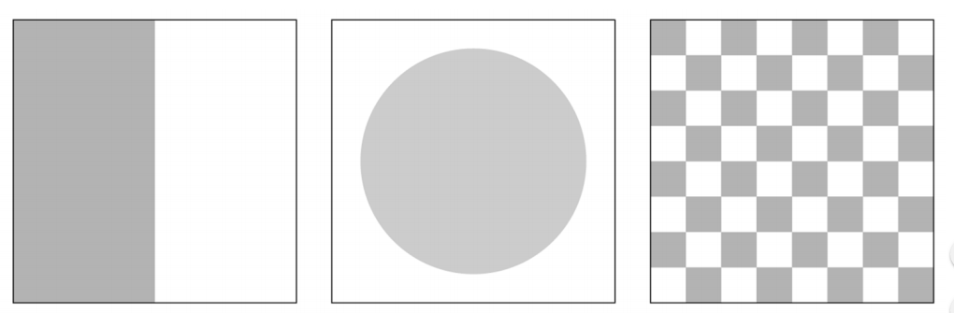
Histograms: only statistical information
No indication of location of pixels
Different images can have same histogram.
3 images below have same histogram :
Same histogram = same statistics
Can we reconstruct image from histogram? No!

Slide 8
Color Histogram
Distribution of the composition of colors in the image.
Different types of colors appeared and the number of pixels in each type of the colors .
The color histogram can be built for any kind of color space, although the term is more often used for three-dimensional spaces like RGB or HSV.
For monochromatic images, the term intensity histogram is used.

Slide 9
The formation of a color histogram : the number of pixels for each 256 scales in each of the 3 RGB channel, and plot them on 3 individual bar graphs.
Color quantization : If the color space is large, then we can first divide the color space into certain numbers of small intervals. Each of the intervals is called a bin.
Then, by counting the number of pixels in each of the bins, we get the color histogram of the image.

Slide 10
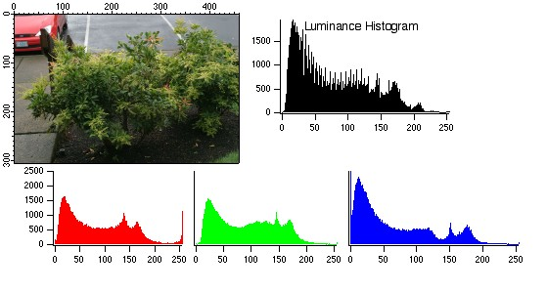
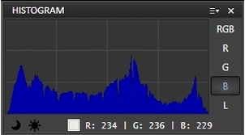

Slide 11
2.
Brightness and Contrast

Slide 12
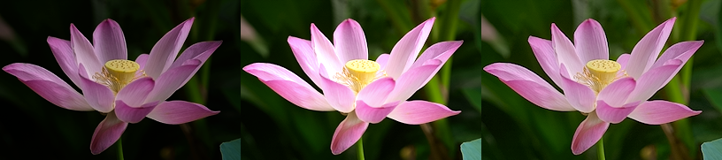
Brightness
Relative term, visual perception
Amount of energy output by a source of light relative to the source we are comparing it to.
Absolute value of colors (tones) lightness/darkness. Increasing brightness :light out all colors so the original light ones will become up to white. Decreasing brightness will darken all colors so the original shaded ones will become up to black.

Slide 13
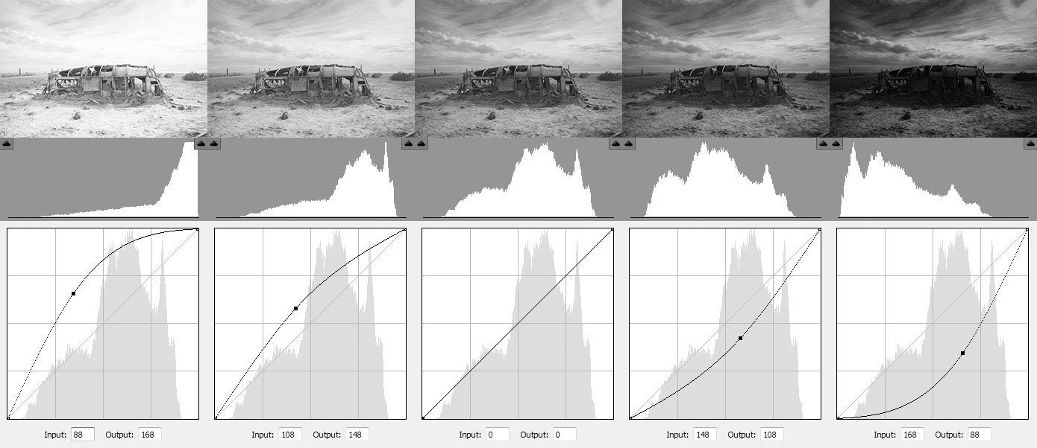

Slide 14
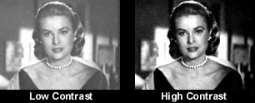
Contrast
Difference between maximum & minimum pixel intensity in an image.
Contrast is the distinction between lighter & darker areas of an image.
Increasing contrast : Increase the difference between light and dark areas so light areas will become lighter & dark areas will become darker.
Decreasing the contrast will make lighter & darker areas stay approximately the same but the overall image becomes more “flat” and starts looking as if it were “washed out”.

Slide 15
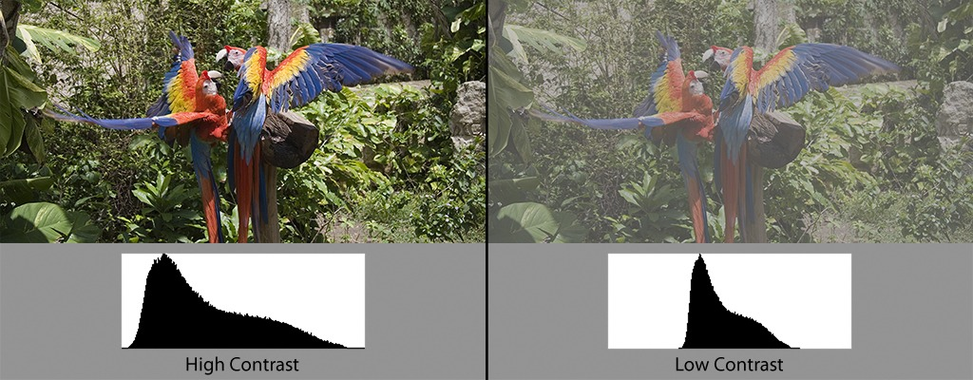

Slide 16
3.
Histogram Equalization

Slide 17
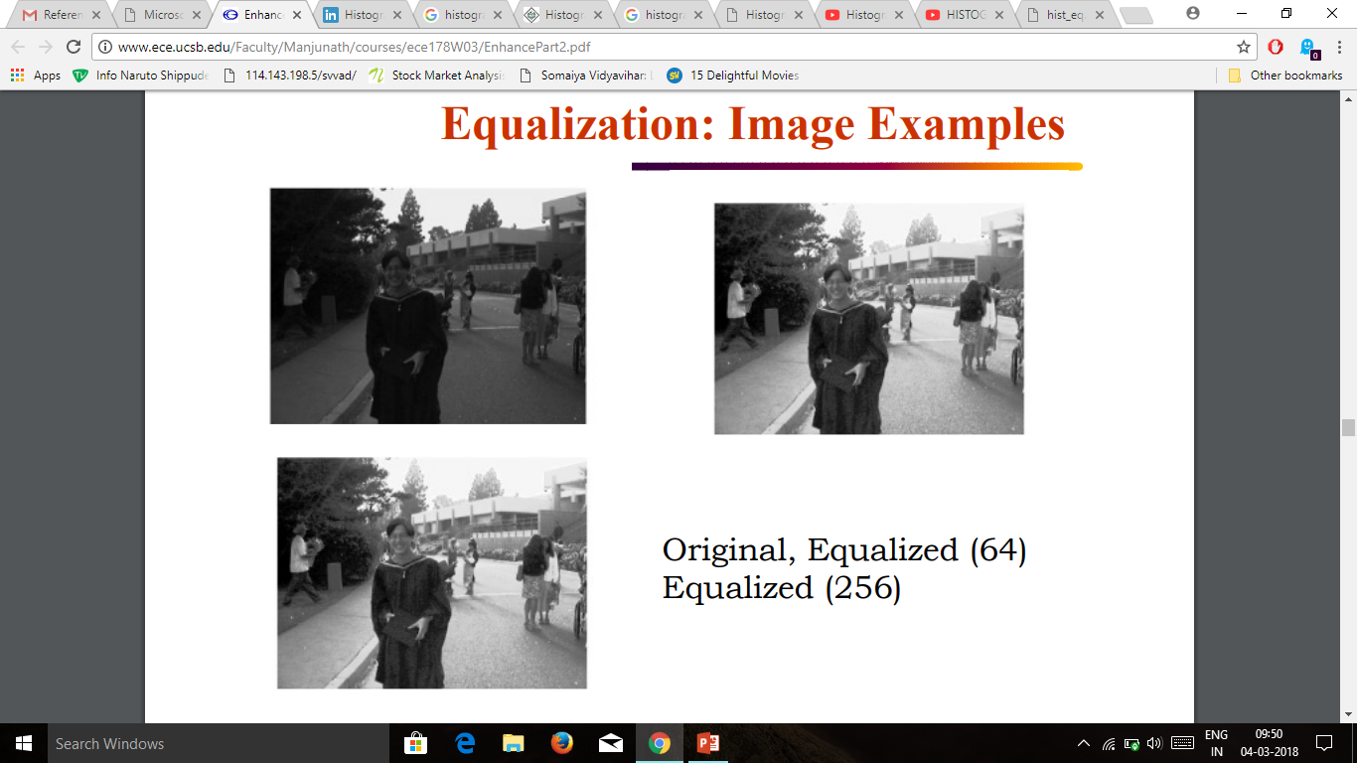
Histogram equalization is a technique for adjusting image intensities to enhance contrast.
ORIGINAL
EQUALIZED
(64 levels)
EQUALIZED
(256 levels)

Slide 18
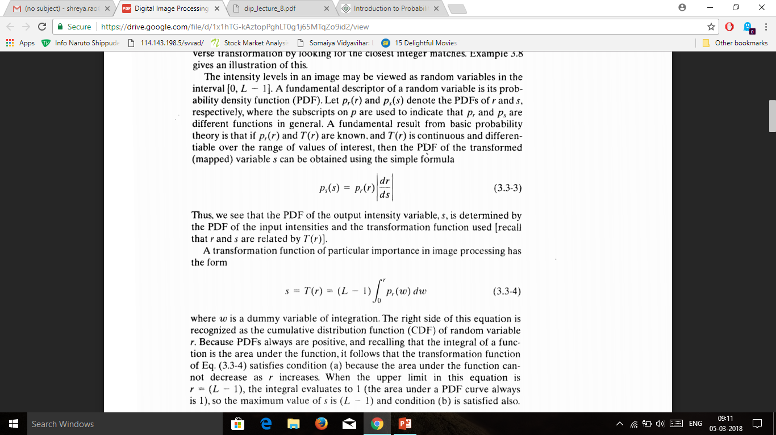
s= T(r) 0 ≤ r ≤ L-1
where s is output intensity level for every pixel in the input having intensity r
PDF
CDF

Slide 19
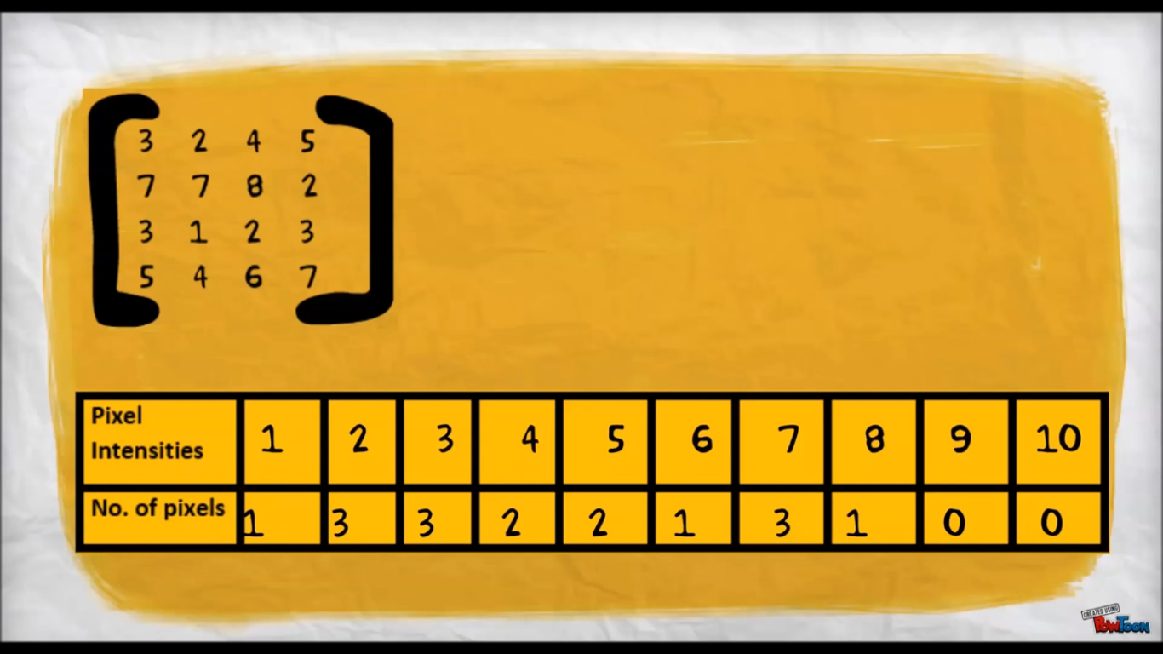
Let each element be a pixel of an image and values of the element represent intensities of the pixels.
Now intensities vary from 1-8
Suppose we want to perform histogram equalization on this image and scale intensity to 1-20

Slide 20

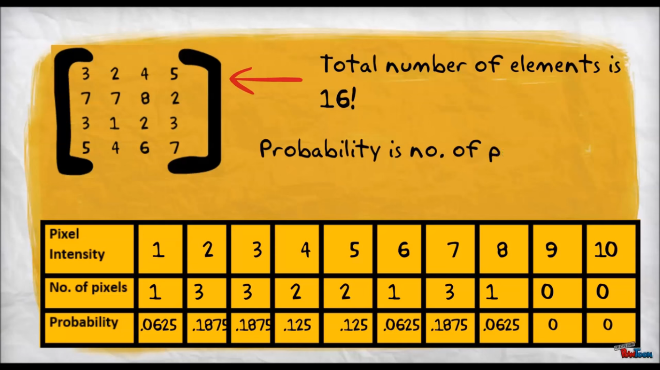
Total number of pixels is 16
Probability = No. of pixels `
Total no. of pixels

Slide 21
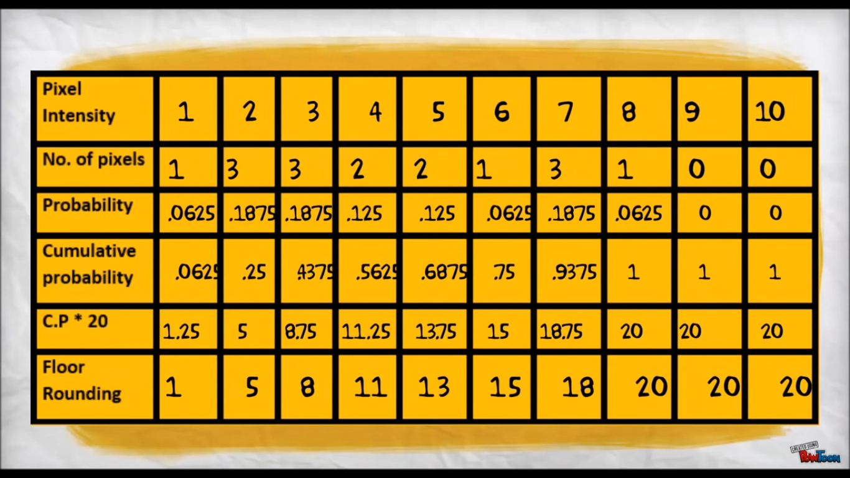

Slide 22
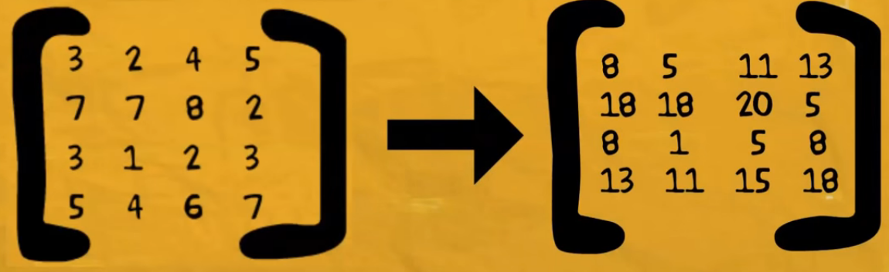

So the original image has been transformed to equalized image with different intensity on each pixel

Slide 23
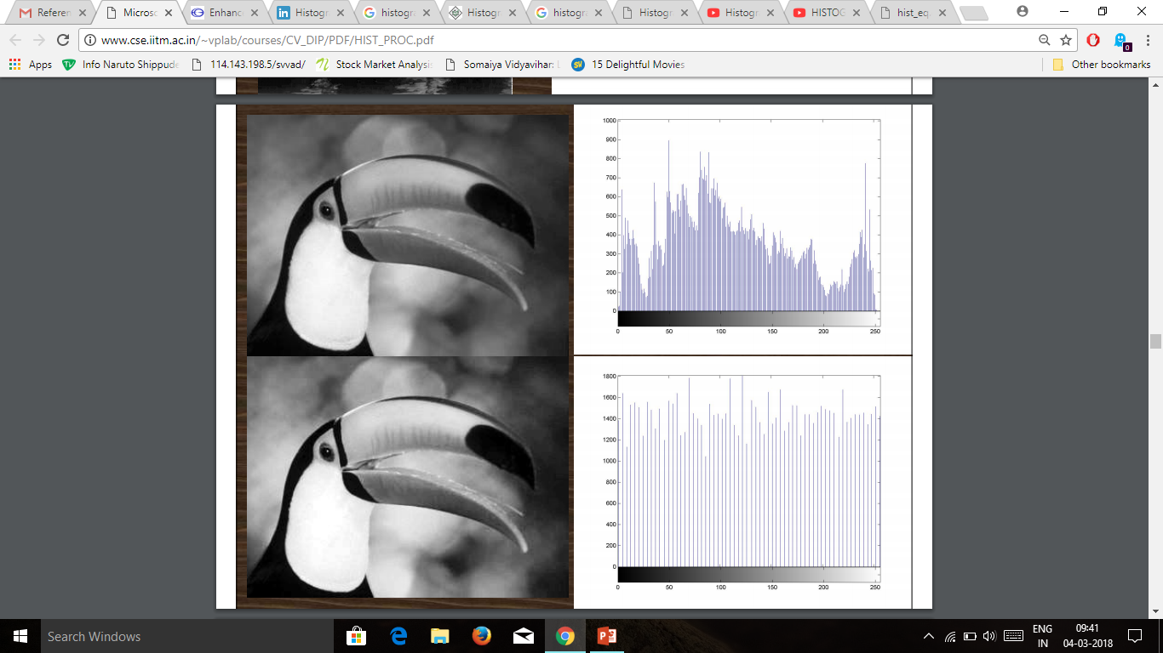
Images Histograms

Slide 24
Problems In Histogram Equalization
Only generates one result: an image with approximately uniform histogram (without any flexibility)
Enhancement may not be achieved as desired
Mean brightness of the histogram equalized image is always the middle gray level regardless of the input mean.

Slide 25
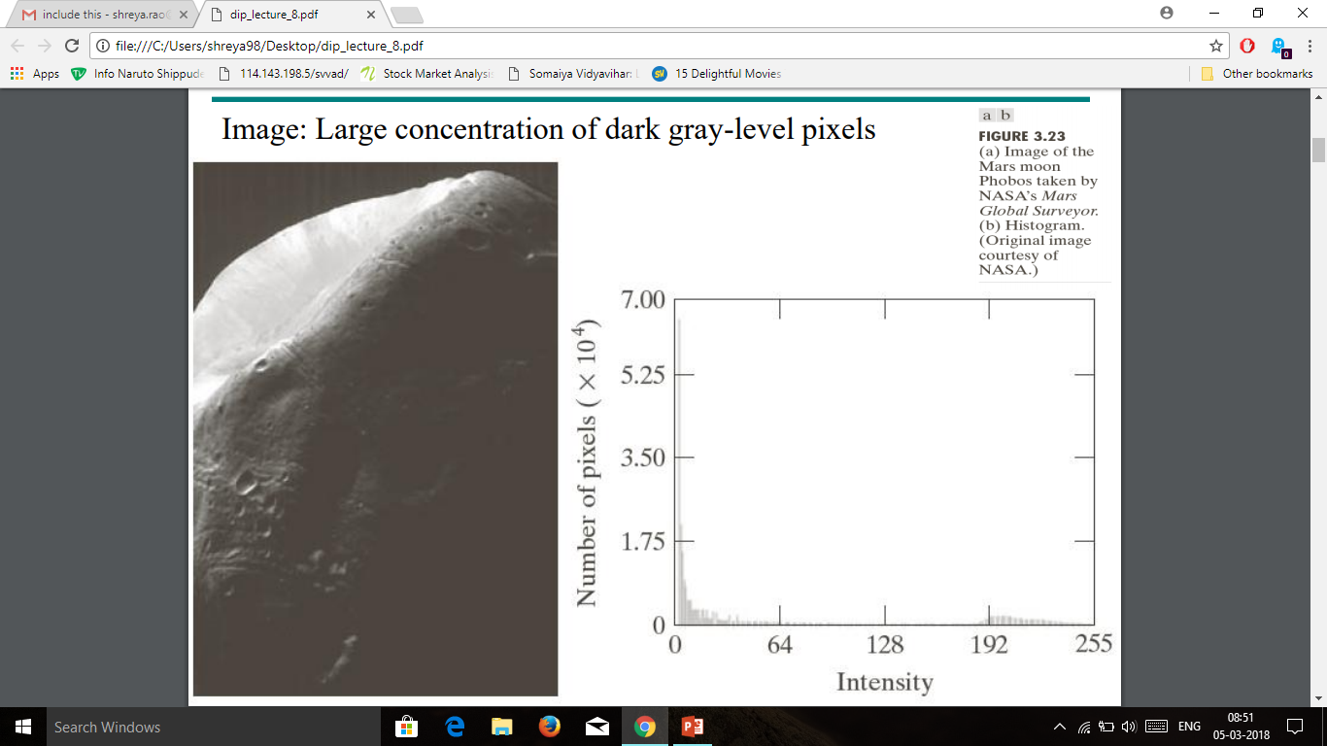
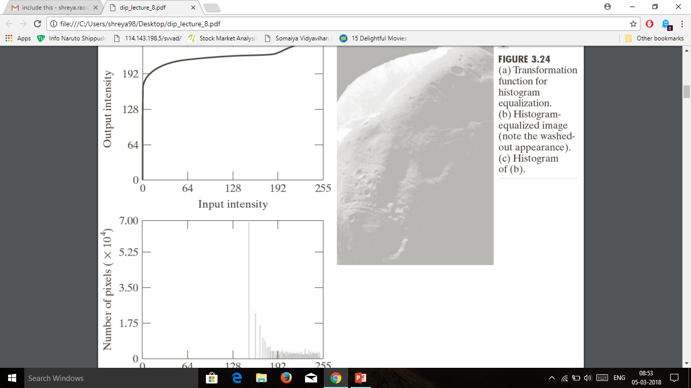
Image: Large concentration of dark gray-level pixels
Histogram-equalized image
(Washed out appearance)

Slide 26
4. Histogram Matching

Slide 27
Transform an image according to a specified gray-level histogram
Specify particular histogram shapes (p_{z}(z)) capable of highlighting certain gray-level ranges
Obtain the transformation function for transformation of r to z
Step1: Equalize the levels of the original image
Step 2: Specify the desired pdf and obtain the transformation function
Step 3: Apply the inverse transformation function to the levels obtained in step 1

Slide 28
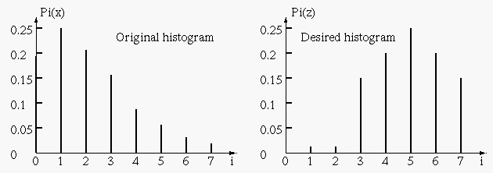
The histogram of the given image and the histogram desired are shown below:

Slide 29
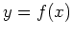
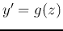
Step 1: Equalize to get mapping
Step 2: Equalize to get mapping

Slide 30
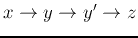
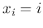
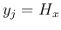
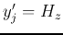
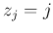
Step 3: Obtain overall mapping,
0 | 0.19 | 0.0 | 3
1 | 0.44 | 0.0 | 4
2 | 0.65 | 0.0 | 5
3 | 0.81 | 0.15 | 6
4 | 0.89 | 0.35 | 6
5 | 0.95 | 0.65 | 7
6 | 0.98 | 0.85 | 7
7 | 1.0 | 1.0 | 7

Slide 31
Here is the look-up table:
i | 0 | 1 | 2 | 3 | 4 | 5 | 6 | 7
j | 3 | 4 | 5 | 6 | 6 | 7 | 7 | 7

Slide 32
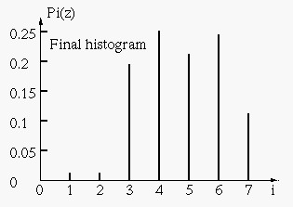
This is the histogram of the resulting image:

Slide 33
5. Local Enhancement and Image Statistics

Slide 34
Local Enhancement
The histogram processing methods discussed till now are global.
There are cases in which we need to only enhance image in smaller areas, for e.g. Spots hiding, censoring, red eye reduction, portrait mode edge detection etc.
The solution is to devise transformations based on the properties of a specific area of the image, based on neighborhood of the required pixels to be enhanced.

Slide 35
Procedure
Define a square (or rectangular) neighborhood and move the center of this area from pixel to pixel.
At each location, the histogram of the points in the neighborhood is computed and either a histogram equalization or histogram specification transformation function is obtained.
This function is then used for enhancement at each neighborhood iteration based on contrast or brightness.
The center is then moved to an adjacent pixel location and step 2 is repeated until we’ve covered the desired area to be enhanced.

Slide 36
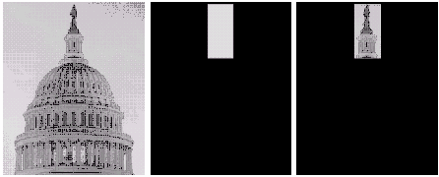
ORIGINAL IMAGE
IMAGE MASK for AND function
Resultant Neighborhood

Slide 37
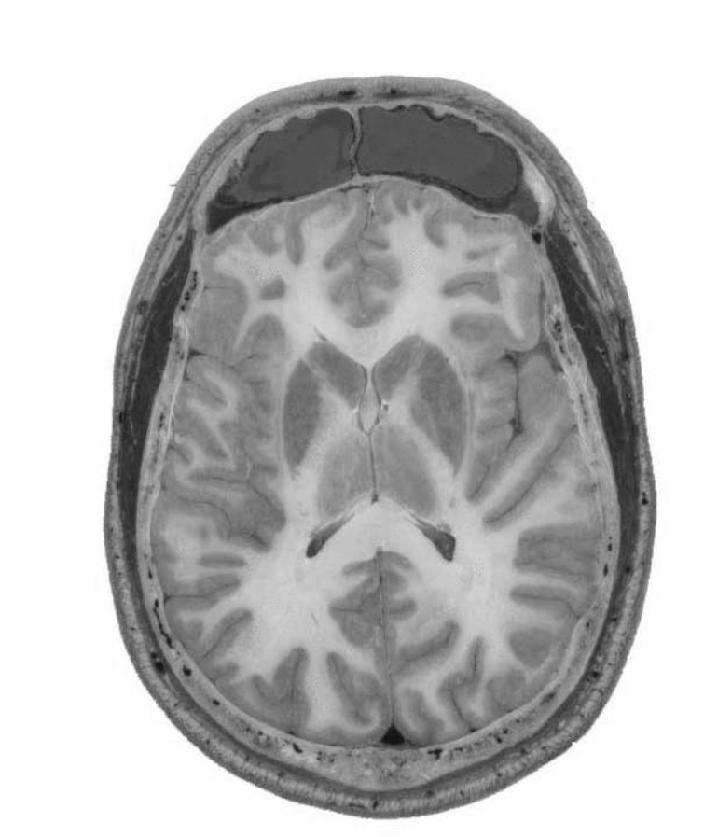
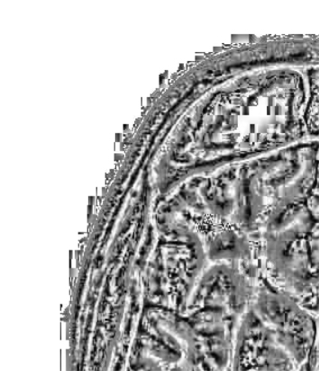

Slide 38
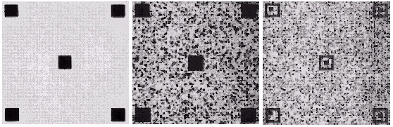
Try Blurring
Try Increasing Contrast
Local Transformation

Slide 39
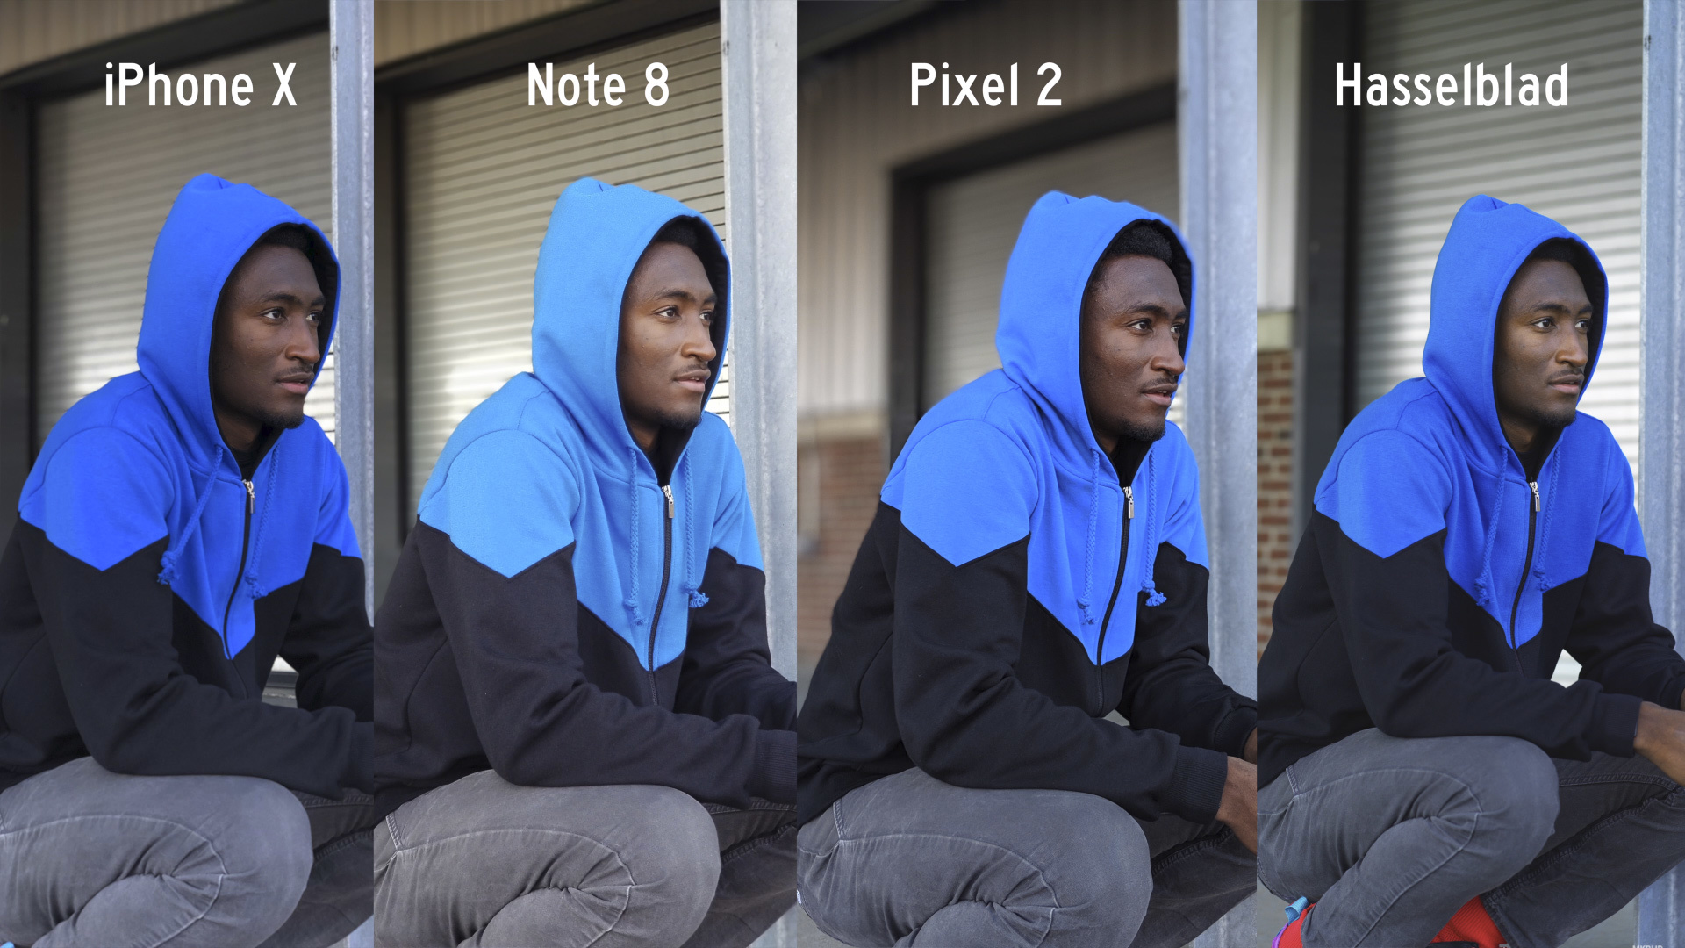

Slide 40
Why Image Enhancement?
The aim of image enhancement is to improve the visual appearance of an image, or to provide a “better transform representation for future automated image processing.
Many images like medical images, satellite images, aerial images and even real life photographs suffer from poor contrast and noise.
It is necessary to enhance the contrast and remove the noise to increase image quality.
Enhancement techniques which improves the quality (clarity) of images for human viewing, removing blurring and noise, increasing contrast, and revealing details are examples of enhancement operations.

Slide 41
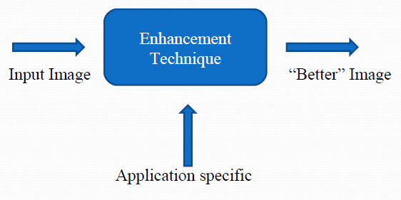
What is Image Enhancement?
Image enhancement process consists of a collection of techniques that seek to improve the visual appearance of an image or to convert the image to a form better suited for analysis by a human or machine.
The principal objective of image enhancement is to modify attributes of an image to make it more suitable for a given task and a specific observer.

Slide 42
Histogram Statistics For Image Enhancement
Let r denote a discrete random variable representing intensity value in the range [0 , L-1].
Let p(r_{i}) denote normalized histogram component corresponding to value r_{i}.
We may view p(r_{i}) as an estimate of the probability that intensity r_{i} occurs in the image from the histogram.
The mean (average intensity) is expressed as:

Slide 43
Example: Scanning Electron Microscope

Slide 44
Example: Digital Photography

Slide 45
Example: Iris Recognition

Slide 46
6. Applications of Histogram Processing

Slide 47
Applications
CT lung studies
Thresholding
Normalization of MRI images
Presentation of high dynamic images (IR, CT)

Slide 48
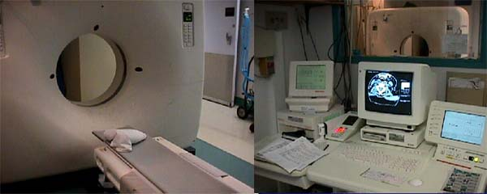
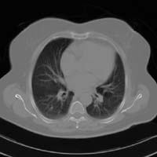
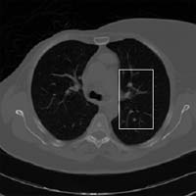
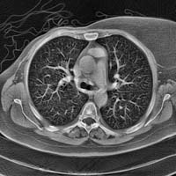
CT lung studies

Slide 49
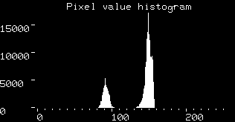
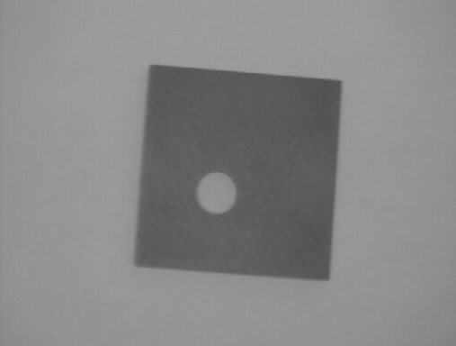

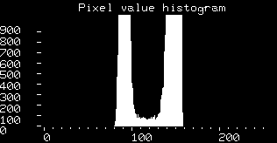
Thresholding

Slide 50
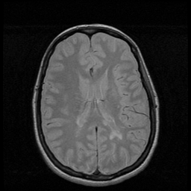
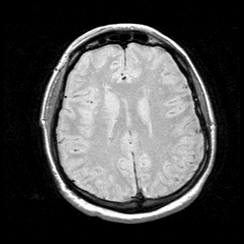
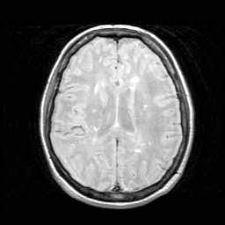
Normalization of MRI images

Slide 51
Advantages & Disadvantages of Histogram Processing

Slide 52
Advantages
Choosing the threshold value for thresholding an image.
Enhancing the contrast of an image.
Automatic techniques for image enhancement.
Par Sectioning
Odd Sectioning.
Histogram Expansion.
Reduction of Image Noise.
Helps avoid taking over‐exposed pictures.
Also easier to detect types of processing previously applied to image

Slide 53
Disadvantages
Computationally very slow.
Problems with odd sectioning
Chances of Histogram Expansion method failure.
Par Sectioning is not easy to implement.
Image Adjusting is complicated

Slide 54
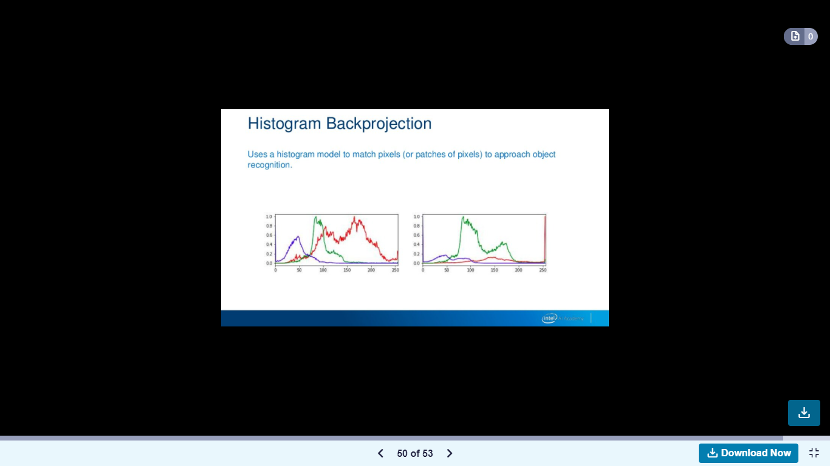

Slide 55
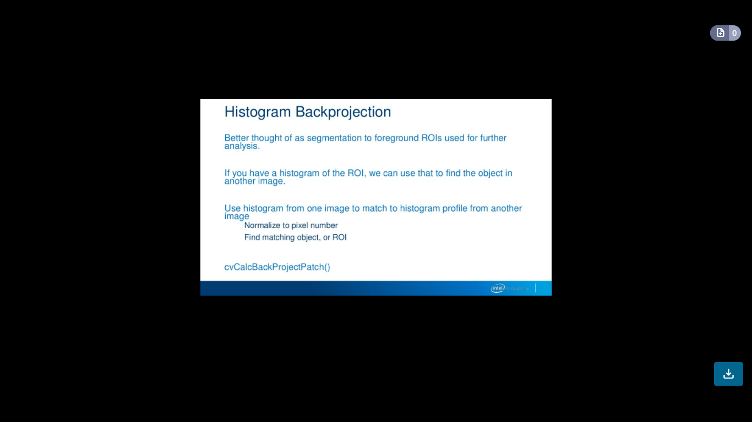

Slide 56
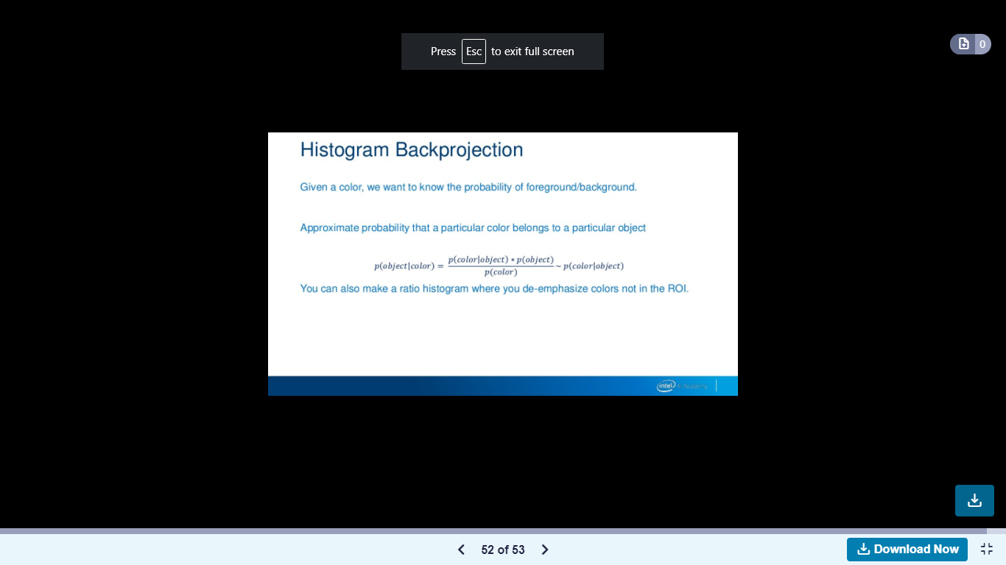

Slide 57
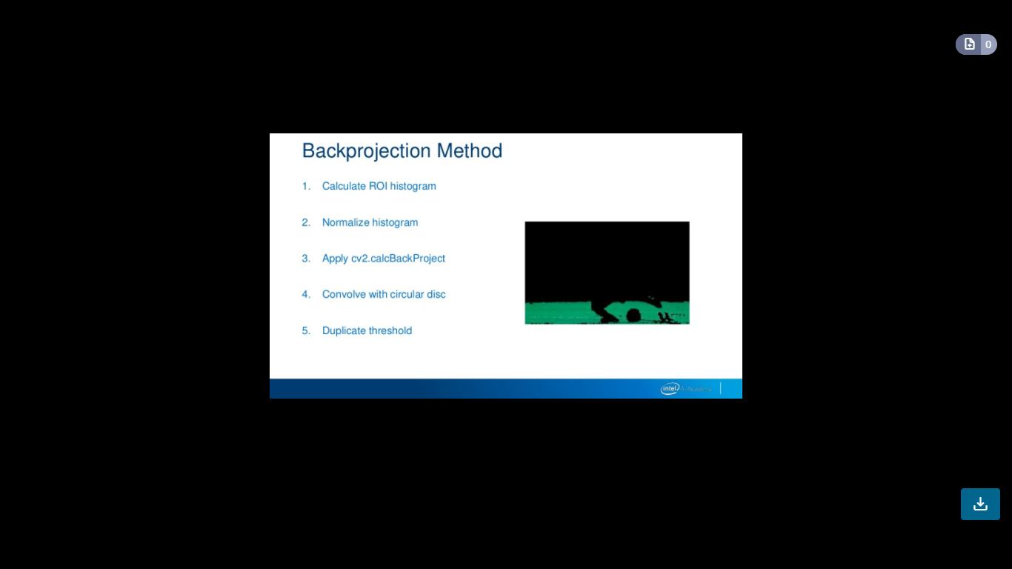

Slide 58
Thanks!
Any questions?

